Slide 1
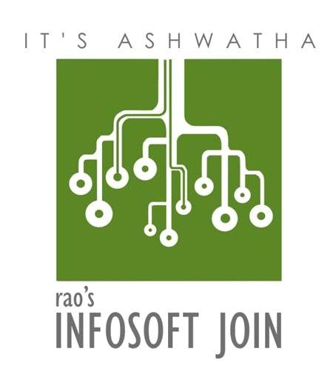
Proposal from Rao’s Infosoft Join Pvt Ltd
Ver3.14. March 2024

Slide 2












Technology Innovation
Django/ReactJS Web Development
Serverless Apps
Event-Driven
Architecture with Kafka, Message Queues, and WebSockets
API Design and Development
❖ Systems Integration
❖ Product Lifecycle
Management
❖ Mobile App Development
Server Environment Optimization
Automated Patch Deployment
Scheduled System Maintenance
License Compliance Management
Endpoint Security Enforcement
Real-Time Health
Diagnostics
24/7 System Monitoring
Systems Virtualization
Citrix Implementation Desktop as a Service (DaaS)
Workspace Optimization VMware, ESXi, Redhat
AWS, Azure & GCP
Infrastructure-as-a-Service (IaaS)
❖ Cloud Security
❖ Compliance
Management
❖ Cloud Orchestration
❖ Cloud Automation
❖ Cloud Migration
Assessment & Strategy
CI/CD Pipelines Infrastructure as Code (IaC) Monitoring & Logging Containerisation & Orchestration
Cloud & Multi-Cloud DevSecOps Toolchain Integration
Foundation LLMs Integrations - OpenAI, AI21
Data Modelling ML/analytics tools like Tensorflow, Pandas, NumPy, and SciPy

Slide 3
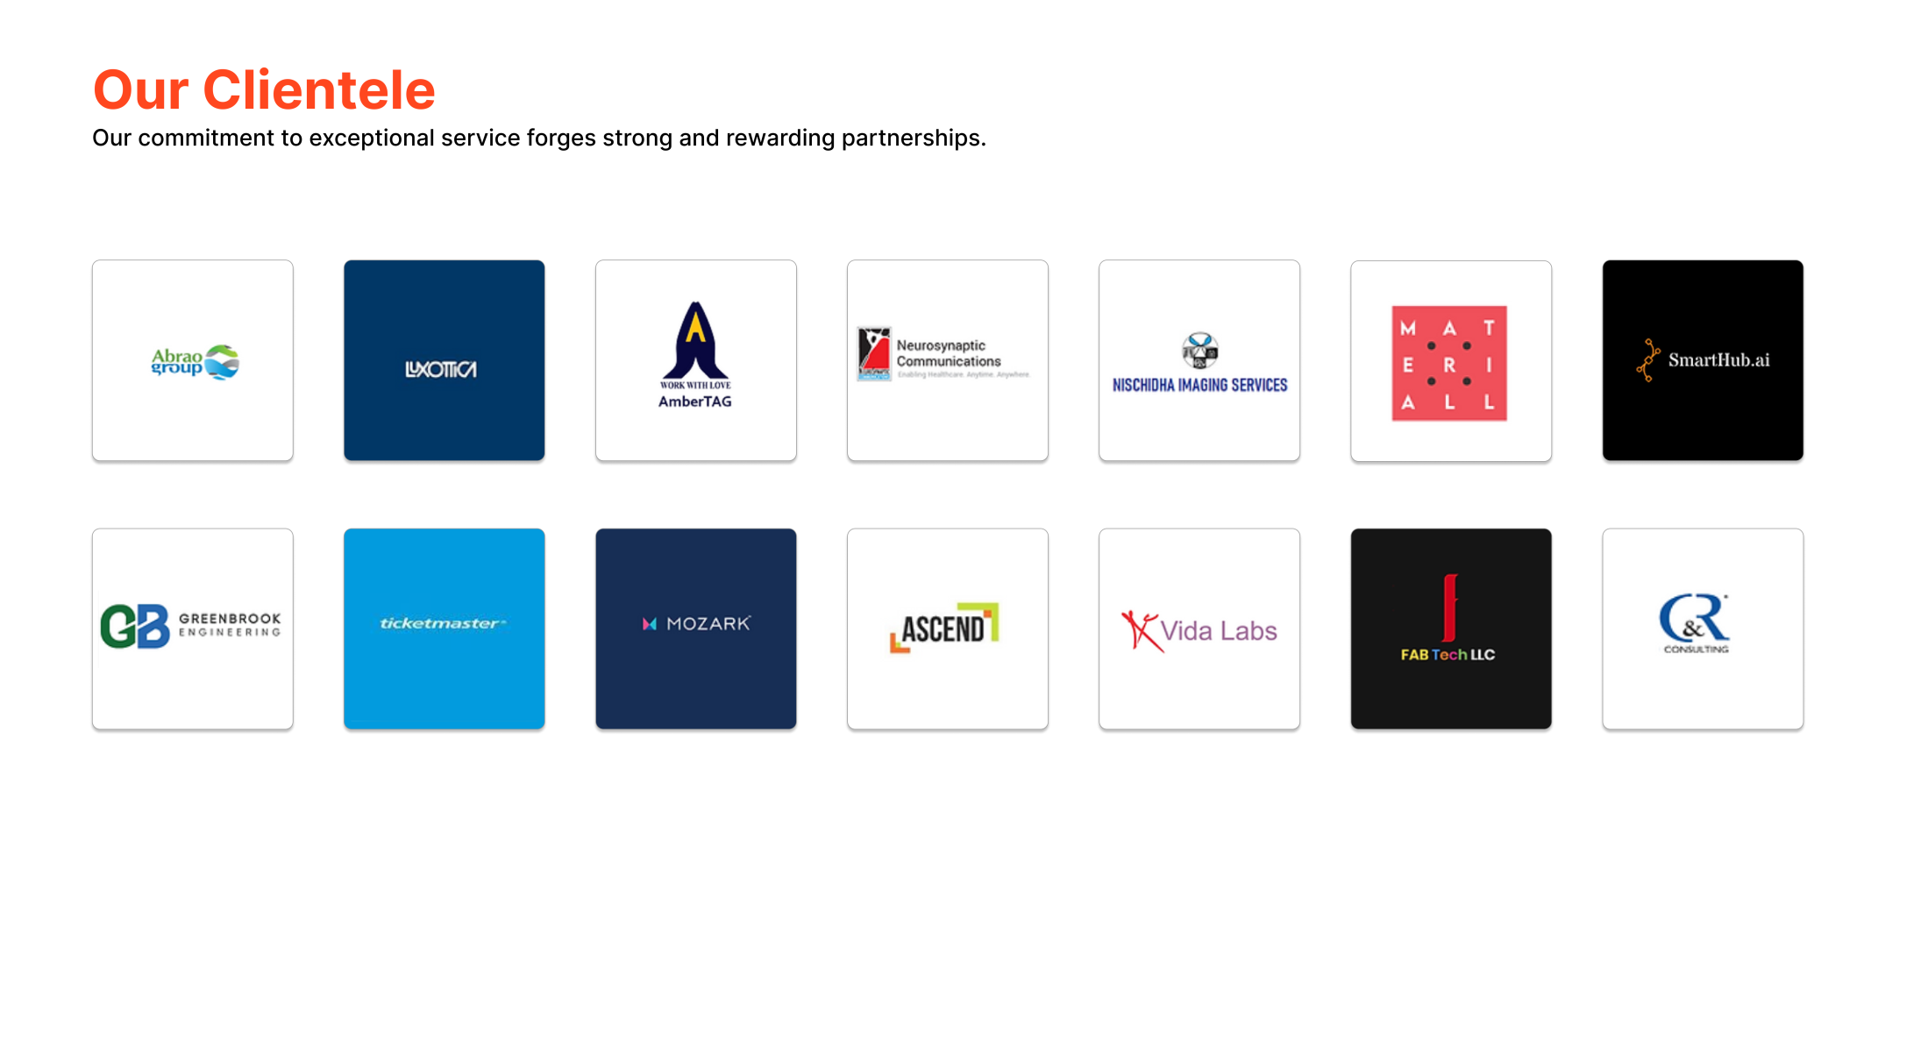
Our Clientele
Our commitment to exceptional service forges strong and rewarding partnerships.

Slide 4
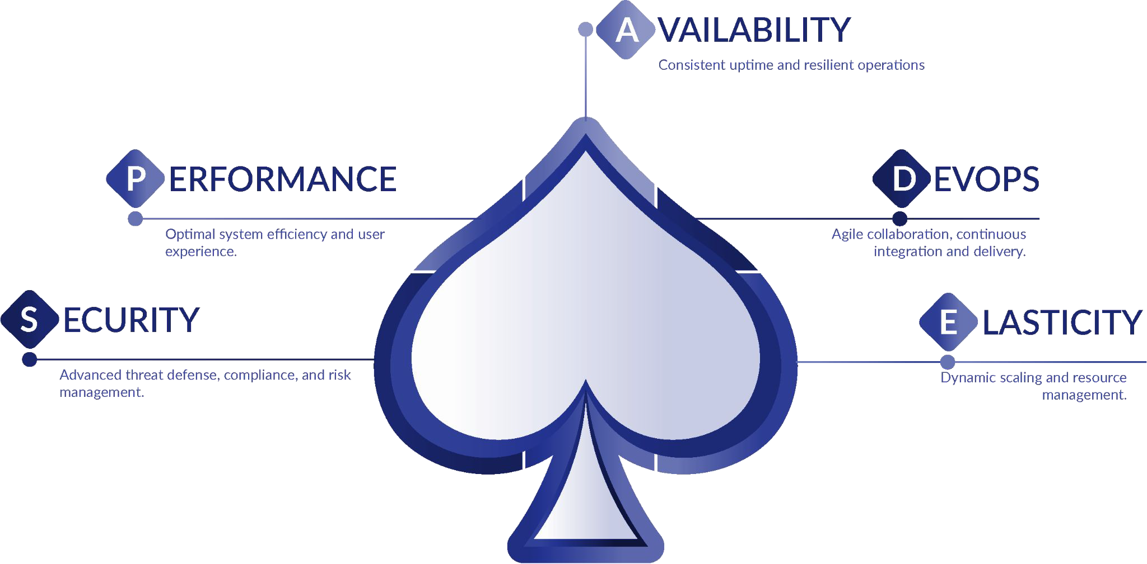
SPADE™ - The Diﬀerence
Our Five-Spoke Engineering Approach to elevate your IT Strategy

Slide 5
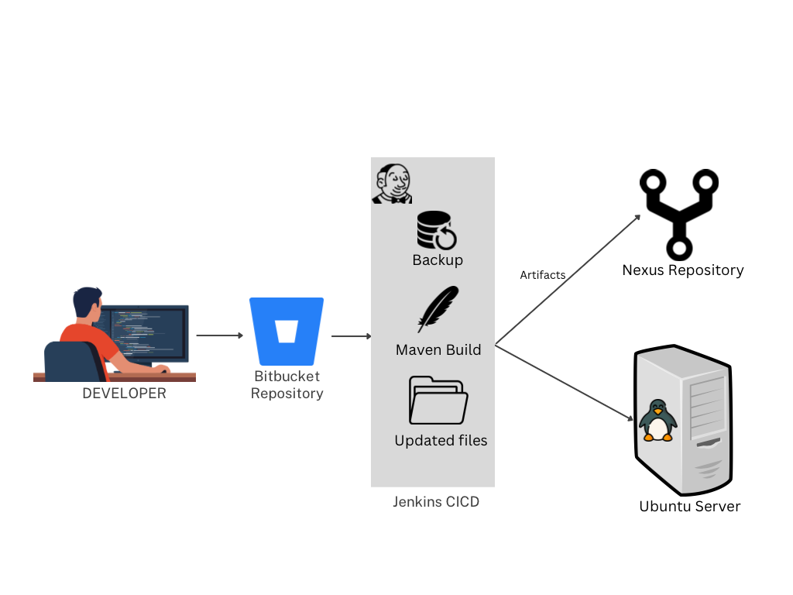
CICD Deployment On-Prem - T-Mobile, US
""Experience seamless automation with our project! Watch as developers commit their code to Bitbucket, triggering CI/CD pipeline. Witness CI/CD tool meticulously checking out code, building it with Build Tools, and even taking backups before deploying artifacts to Spark application server. This pipeline effortlessly deploys Spark applications to your on-prem Linux server. And that's not all - Jenkins also identifies and deploys newly added and updated schema files to their respective folders to on-prem server. Likewise, Streamline your development process with our comprehensive solution."

Slide 6
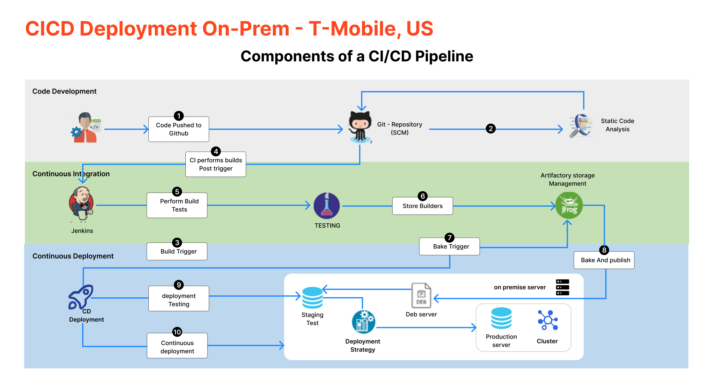
CICD Deployment On-Prem - T-Mobile, US

Slide 7
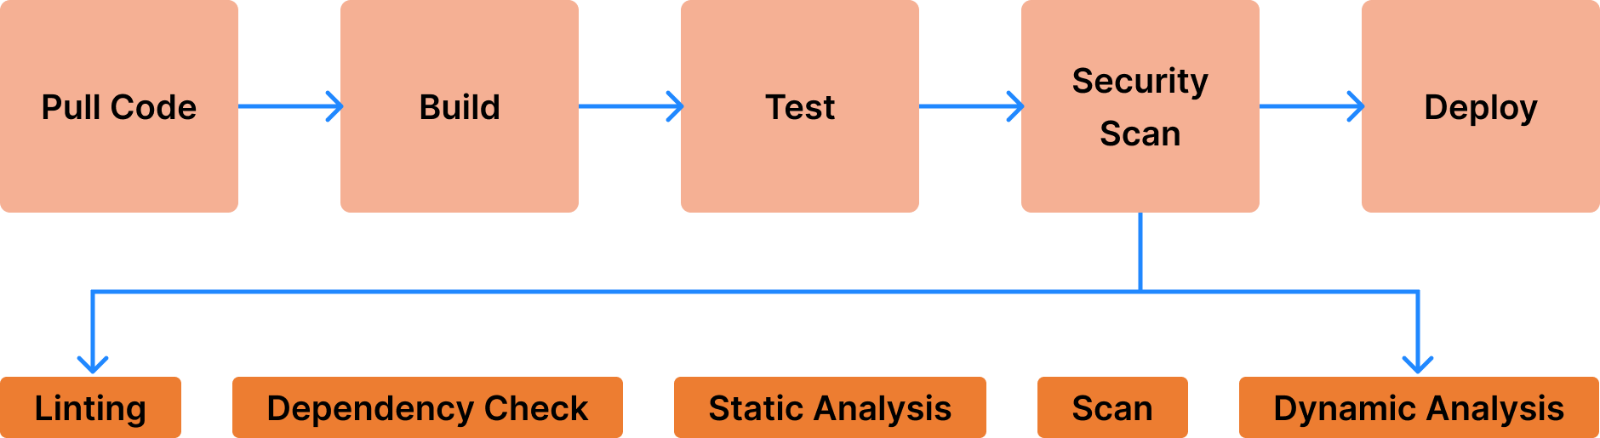
Seamless Deployment using DevSecOps - US Based Client
"This project exemplifies DevSecOps by automating the deployment of any Application via CI/CD Pipeline. The pipeline conducts thorough bug and vulnerability checks, creates container images, and pushes them to on Prem server. Deployed containers on K8S utilizes the on prem server for storage and databases. Additionally, Grafana is configured to monitor the K8S cluster, ensuring robust performance and security throughout."

Slide 8
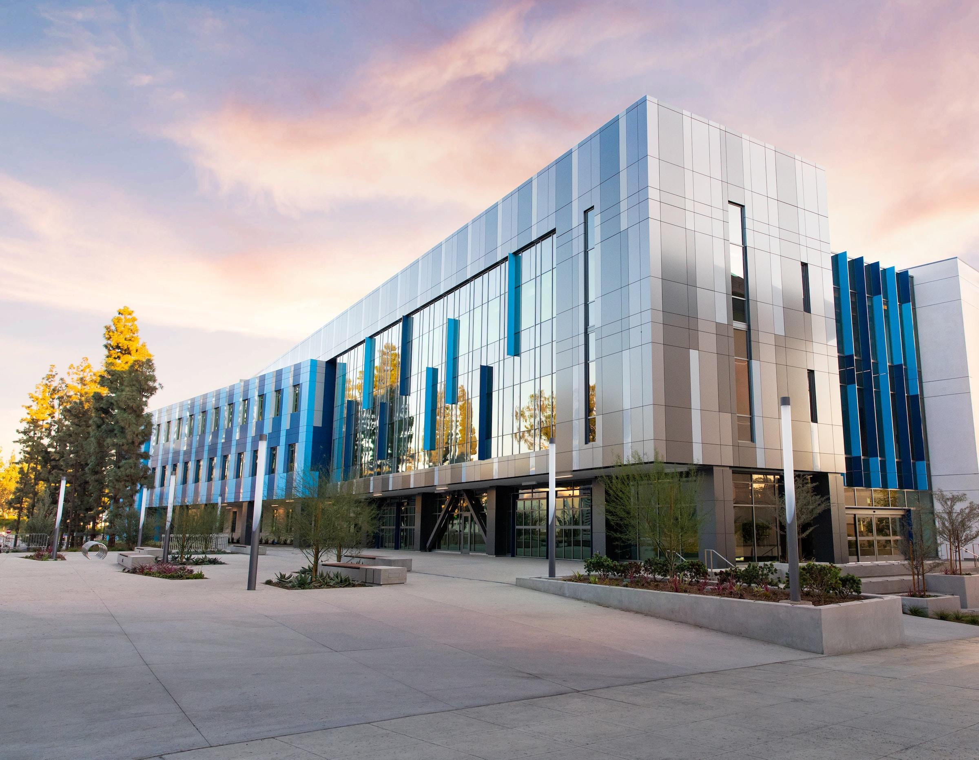


Contact Us
REACH US
REACH US
+91 98808 39078
suthindran.rao@gmail.com

